Slide 1
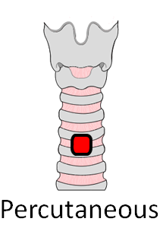
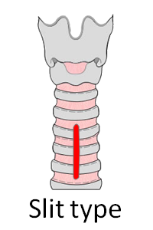
This patient has a TRACHEOSTOMY
There is a potentially patent upper airway (Intubation may be difficult)
Surgical / Percutaneous
Performed on (date) ..............................
Tracheostomy tube size (if present) ...............
Hospital / NHS number ..............................
Notes: Indicate tracheostomy type by circling the relevant figure.
Indicate location and function of any sutures.
Indicate if inner tube present.
Laryngoscopy grade and notes on upper airway management.
Any problems with this tracheostomy.
Check tracheostomy emergency kit at bedside
Emergency Call: DIAL 2222 and state ANAESTHETIC EMERGENCY TEAM and your location Anaesthesia/ICU Bleep 1319 CCOT Bleep 1374

Slide 2
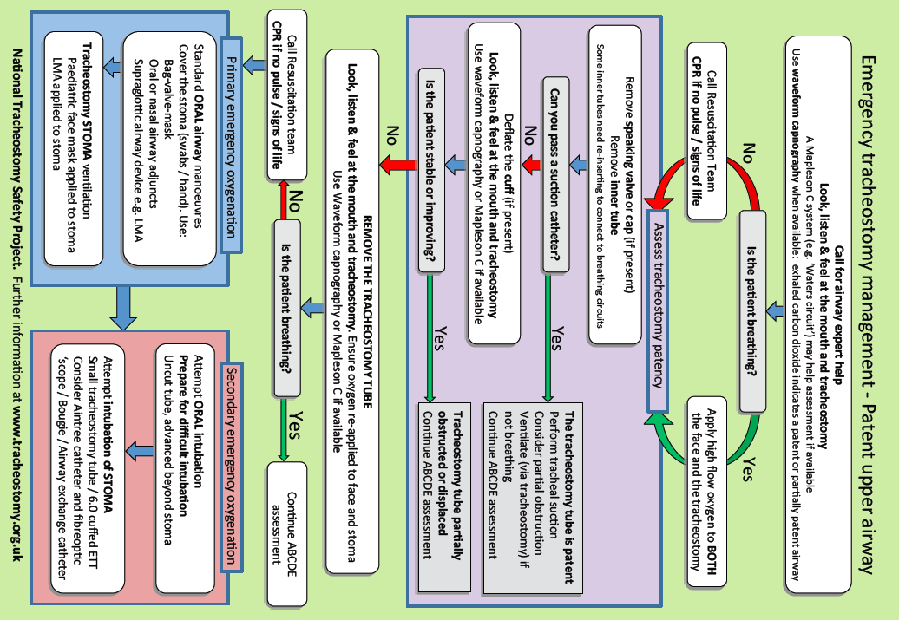
National Tracheostomy Safety Project. Review date 1/1/22. Feedback & resources at www.tracheostomy.org.uk

Slide 3
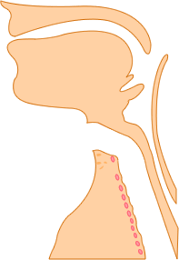
This patient has a LARYNGECTOMY
and CANNOT be intubated or oxygenated via the mouth
Follow the LARYNGECTOMY algorithm of breathing difficulties
Performed on (date) ..............................
Tracheostomy tube size (if present) ...............
Hospital / NHS number ..............................
Notes:
There may not be a tube in the stoma.
The trachea (wind pipe) ends at the neck stoma
Check tracheostomy emergency kit at bedside
Emergency Call: DIAL 2222 and state ANAESTHETIC EMERGENCY TEAM and your location Anaesthesia/ICU Bleep 1319 CCOT Bleep 1374

Slide 4
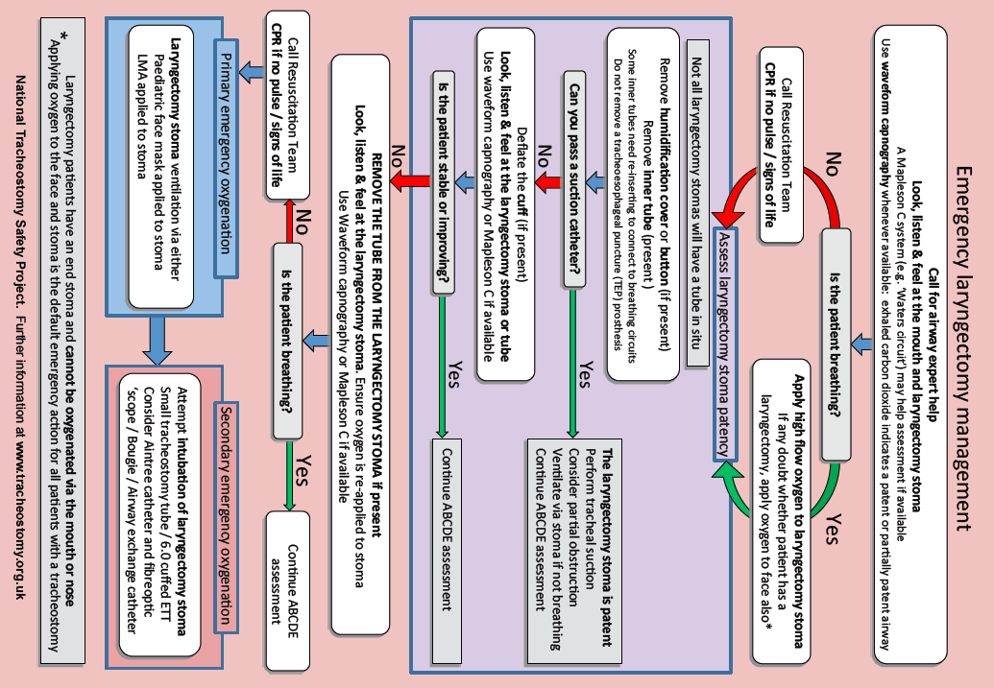
National Tracheostomy Safety Project. Review date 1/1/22. Feedback & resources at www.tracheostomy.org.uk

