Slide 1
Patient initiated follow-up implementation plan and pre-implementation checklist
nhsi.outpatient-transformation@nhs.net

Slide 2
What are patient initiated follow-ups?
“Patient initiated follow-up” (PIFU) describes when a patient (or carer) can initiate follow-up appointments as and when required, e.g. when symptoms or circumstances change.
It was highlighted as a key priority in the NHS’ COVID-19 recovery, and national guidance was included in the phase 3 resources.
It is used in lots of places already, but sometimes called different things, including:
Open access follow up
Patient led follow-up
Patient triggered follow-up
Patient initiated appointments
Supported self-managed follow-up
Self-managed follow-up
See on symptom
Open appointments
Open self-referral appointments
Patient-activated care
Helps avoid unnecessary trips to hospital
Helps people take control of their own healthcare
Gives people an option to have appointments when they need it e.g. during a flare up
Helps reduce pressure on services
Personalised
High quality of care
Clinically-led

Slide 3
About this guide
This document has been produced to aid systems and trusts in their implementation of PIFU, or improving how they use PIFU so that they can get the most benefit for patients and services.
It is intended that this is used by systems’ and trusts’ project managers to:
Get ready for implementing PIFU at pace
Identify who needs to be involved
Plan key activities that will be needed as part of that implementation
Estimate the time required for each stage of the roll out
Find examples to “lift and shift” from existing national resources and case studies from elsewhere in the country
Ensure that your model of PIFU is in line with national guidance and delivers safe and high quality of care to patients
Ensure that you are adopting good practice in recording and reporting PIFU

Slide 4
PIFU rapid implementation plan overview
Business case / PIFU plan signed off by senior team
Project set up
Small scale go live
Start roll out in next wave of specialties
Pre-implementation
Prepare for go live
Test and refine
Reflect on roll out
Design phase
Embed and sustain
…
8 weeks
2 weeks
3 weeks
2 weeks
Finalise SOP
Finalise clinical resources
Large scale launch
Evaluation for each specialty

Slide 5
Getting ready for roll out: pre-implementation phase
Trusts have told us that the below should be ready before starting implementation. You may also find it useful to review the conditions for change.
1
Review the national PIFU guidance as part of the phase 3 resources.
6
Understand where the opportunity is by analysing:
Number of follow-ups per specialty (or number of outpatient appointments per specialty)
Follow-up waiting lists/waiting times (or outpatient waiting lists/waiting times)
Services with greatest number of long term patients
Review nationally available case study data
2
Identify and engage with your core project team (you may already have an outpatients lead, and you may have multiple people filling the same role):
Senior Sponsor (accountable for success of PIFU roll out)
Project Manager (responsible for day-to-day management of PIFU roll out)
Information Lead (responsible for producing data on success of PIFU roll out)
IT Lead (responsible for scoping and implementing changes to systems to support PIFU delivery)
Comms Lead (responsible for developing and delivering strategic communications plan to support PIFU)
Local personalised care lead if you have one
This will expand once you have identified your priority specialties
Engage with your Chief Clinical Information Officer
7
Agree your wave 1 specialties to pilot formalised PIFU based on:
Data
Local system priorities
Clinical engagement
Suggest starting with 3-5 specialties including both medical and surgical specialties, and to cover a mix of short and long term pathways of care so that you develop the most flexible model.
Expand project team to include:
Clinical Leads, at least one for each wave 1 specialty (responsible for drafting clinical materials to support the use of PIFU and leading engagement with other clinicians for the specialty)
Operational Managers responsible for clinic management, contact centres, waiting lists (responsible for reviewing and implementing changes to operational management of services)
3
Understand whether you are already using PIFU in some form
Understand whether PIFU is being used already in the organisation (it might be called something else)
If so, understand the extent to whether that is formal (recorded and reported on) or informal (not recorded). If formal, analyse usage and impact.
Engage with cancer leads to understand to what extent personalised stratified follow-up has been implemented in cancer
8
Develop and approve PIFU business case, implementation plan and governance arrangements
4
Understand clinical appetite for PIFU by asking clinicians how they feel about using PIFU in their service
5
Understand local priorities and build connections with other systems/providers
Understand which organisations within your system are already using or implementing PIFU and in what specialties
Understand any system priority specialties for PIFU
Engage with commissioners
Identify any other systems/providers using similar IT systems
Understand what forums there are to share learning about PIFU
Engage with your PIFU regional lead. Email nhsi.outpatient-transformation@nhs.net and we can connect you
9
Set up regular (suggest weekly or fortnightly) meetings with project team including clinical leads and IT leads
Map out delivery milestones, and reporting timelines. Factor in periods where progress may be expected to be slower (e.g. holiday periods)

Slide 6
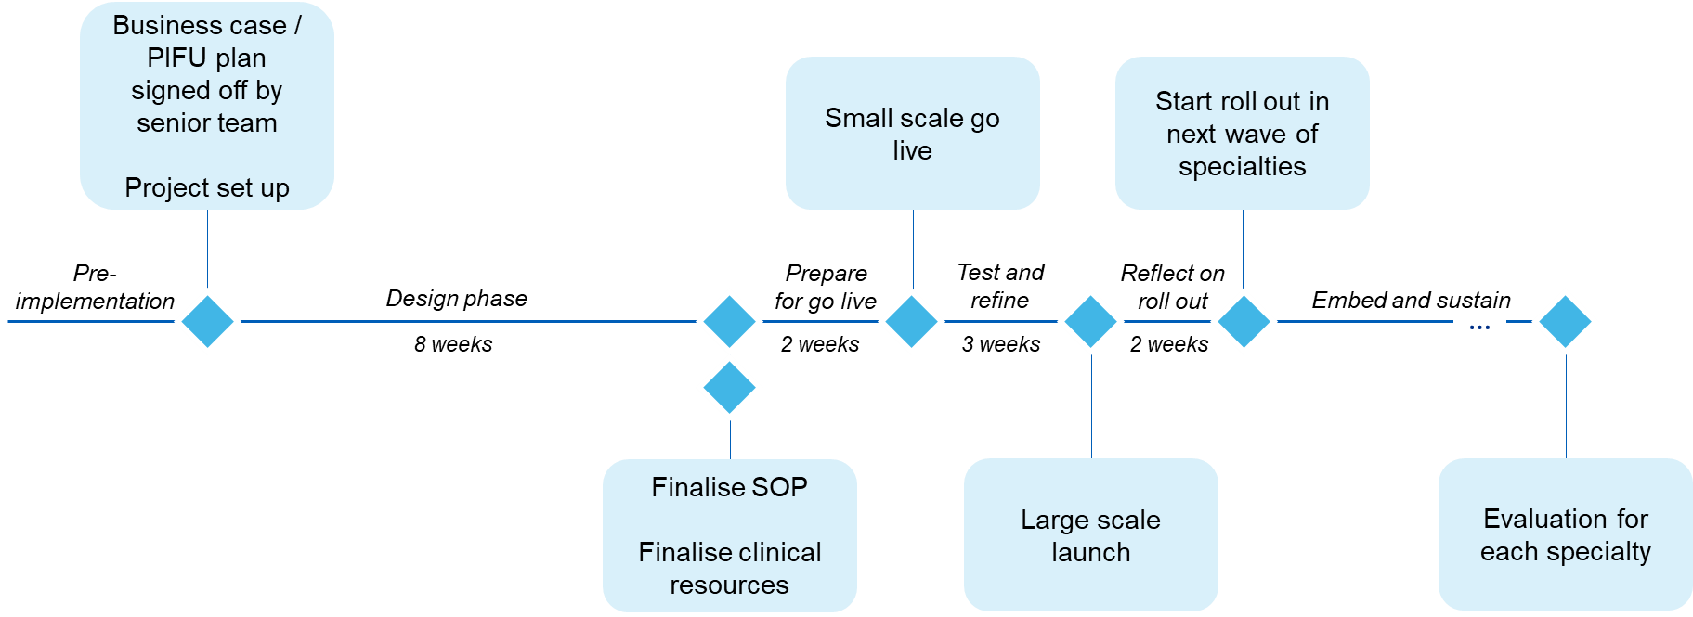
Design phase
How will we get there?
For each specialty, agree which pathways PIFU will be piloted in first
Estimate number of patients and clinicians this would affect
Develop strategic engagement plan
Consider how the change will affect staff (confidence, morale etc) and ensure you have support in place
Identify your clinical and operational champions for each service
Plan how services will manage their capacity over the implementation phase
How do patients feel about this?
Identify or set up patient groups for each specialty and ask them what is important for them
Adapt your plans as needed
How could this affect health inequalities?
Carry out a health inequalities assessment, and plan in actions required to mitigate and reduce inequalities
How will we manage the system changes?
Understand if you can phase system changes or if they will affect everyone all at once
Plan how you will test the system is working
Is this best practice? Do you have required safety nets in place?
Review proposals to ensure they align to best practice, embedding personalised care, shared decision making, safety nets and meet recording and reporting requirements
How many patients in these specialties can PIFU benefit?
Review relevant specialty guides, case studies and webinars on FutureNHS
Engage with other providers / systems already using PIFU in each specialty (regional PIFU leads can help identify them)
Ask clinicians which pathways they see PIFU having the greatest value for patients, e.g. via a clinical engagement workshop
Review your data to estimate how many patients will be impacted for these specialties
How will this work day to day?
Develop a standard operating procedure (template here)
Understand how patients on PIFU can be logged and tracked on your system, how this supports implementation of essential safety nets, and how you will record and report PIFU as part of your national data submissions
Understand how patients will make contact with the service and develop some options to be adopted by services based on clinical need
Engage with others using similar systems ((regional PIFU leads can help identify other providers and systems)
Agree and plan any operational changes or materials required to support (e.g. system changes, changes to clinic templates)
Set your KPIs
Define how PIFU will form part of the organisation’s approach to continuous improvement
What do we need at specialty level?
Identify and produce additional materials for each specialty to sit alongside the SOP, e.g:
Clinical protocols / guidance
Target service response times
PIFU timescales, and action at the end of the timescale
Patient communications
Letter templates
Web pages
Safety nets
Triage process
Booking process and clinic slots
Are there any additional risks to patients or health inequalities at specialty level?
Finalise SOP
Finalise clinical resources

Slide 7
Prepare to go live
Have we told everyone who needs to know?
Update stakeholders on go live plans
Are our systems ready?
Implement any necessary system changes
Test that you are able to record patients as being on a PIFU
Is our data reliable?
Check that patients aren’t already being logged as a PIFU before you have gone live
Small scale go live
How and when will we start using PIFU?
Set a date for your small scale go live (can be different dates for each specialty)
Identify clinicians who will start using it first
How will we know the pilot was a success?
Agree how you will assess the success of the roll out pilot:
Leading and lagging indicators
Staff feedback (clinical and non-clinical)
Patient feedback
Level of uptake
Are our people ready to go?
Train clinical staff in how to log patients in the system, how to discuss PIFU with patients, how triage will work
Train administrative staff in how to manage clinics, and how to manage queries from patients
Give staff the opportunity to ask questions
To note, it is likely you won’t have patients initiate an appointment within your small scale pilot, so you will have to continue to monitor how this goes beyond your large scale launch.

Slide 8
Test and refine
Do we need to change anything?
Review your success measures for the pilot
React to feedback from staff on how things are working so far
Test safety nets and recording and reporting
Are our people ready to go?
Train clinical staff in how to log patients in the system, how to discuss PIFU with patients, how triage will work
Train administrative staff in how to manage clinics, and how to manage queries from patients
Give staff the opportunity to ask questions
Offer staff the option of shared decision making training
Are we ready to expand to other pathways in these specialties?
Decide whether you can use across other pathways
How will we launch at scale?
Plan communications for staff, patients, system partners
Ensure flexible support is available in the first few weeks of using PIFU
Large scale launch
To note, it is likely you won’t have patients initiate an appointment within your small scale pilot, so you will have to continue to monitor how this goes beyond your large scale launch.

Slide 9
Reflect on roll out
What have we learnt?
Review your success measures for the pilot
React to feedback from staff on how things are working so far
How can we celebrate success?
Recognise staff effort
Share results
Share impact
We’d love to help you! Contact us at
nhsi.outpatient-transformation@nhs.net
Start roll out in next wave of specialties
What early results have we seen?
Uptake of PIFU
Some useful benefits and planning tools can be found here
What have can we learn from our system colleagues?
Engage with regional and system colleagues
Where next?
Start engaging with other specialties
Develop a roll out plan for PIFU to show when you expect uptake in each specialty
Develop a plan to improve the current PIFU set up to better align to best practice

Slide 10
Embed and sustain
How will we review and check up to see how PIFU is working?
Set a timetable for reviewing the specialties you have rolled out in
When will we evaluate the data?
Plan in evaluation milestones for each specialties
High level guidance on evaluation can be found here.
…
…
How can we make PIFU business as usual?
Consider embedding as part of staff training
Consider removing alternative “informal PIFU” options where clinically agreed
Consider adding PIFU into job roles for new starters

